Slide 1

CSE 591 Geographic Visualization
Ross Maciejewski
rmacieje@asu.edu

Slide 2
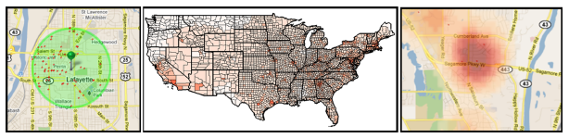
Geovisualization
Geovisualization primarily denotes tools and techniques that are designed to support analyses that focus on datasets with a geographic component
Visual representations are designed and built utilizing cartographic principles
Previous lectures we looked for trends over multivariate data and temporal data
Today, we look for trends over geographic regions

Slide 3
Geographic Visualization
Utilize sophisticated, interactive maps to explore information
Recent work focuses on incorporating temporal components into analysis
Moving towards a combination of interactive maps and statistical analysis methods
Tobler’s first law of geography: “Everything is related to everything else, but near things are more related than distant things”¹
Tobler W., (1970) "A computer movie simulating urban growth in the Detroit region". Economic Geography, 46(2): 234-240

Slide 4
Thematic Maps
A thematic map (or statistical map) is used to display the spatial pattern of a theme or attribute
Focus is on spatial pattern as opposed to a general-reference map which focuses on location
Goal of a thematic map is to emphasize spatial patterns of geographic attributes (e.g., population density)
How are thematic maps used?
To provide specific information about particular locations
To provide general information about spatial patterns
To compare patterns on multiple maps
TA Slocum, RB McMaster, FC Kessler and HH Howard, “Thematic Cartography and Geovisualization,” Prentice Hall Series, 2009.

Slide 5
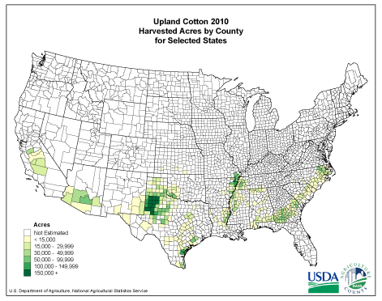
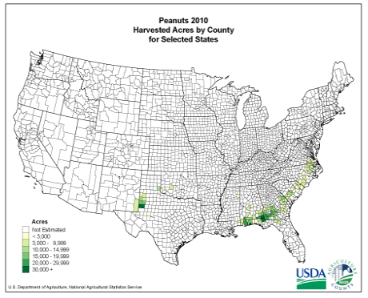
Thematic Maps

Slide 6
Basic Steps for Communicating Map Information
Consider what the real-world distribution of the phenomenon might look like
Determine the purpose of the map and the intended audience
Collect data appropriate for the map’s purpose
Design and construct the map
Determine whether users find the map useful/informative
TA Slocum, RB McMaster, FC Kessler and HH Howard, “Thematic Cartography and Geovisualization,” Prentice Hall Series, 2009.

Slide 7
Map Phenomena
One way to think about geographic phenomena is to consider their spatial dimension
Five types of phenomena
Point phenomena – no spatial extent (weather recording devices, oil wells)
Linear phenomena – one dimensional, length but no width (country borders)
Areal phenomena – have length and width (lakes)
2.5 D Phenomena – surface (height above sea level)
3D Phenomena – have a value at any location within the volume (concentration of carbon dioxide)
TA Slocum, RB McMaster, FC Kessler and HH Howard, “Thematic Cartography and Geovisualization,” Prentice Hall Series, 2009.

Slide 8
Coordinate Systems
We need a way to define locations on a map (need to specify points, lines, polygons etc.)
Typically use Cartesian coordinates
Types of Map Coordinate Systems:
Latitude/Longitude
Universal Transverse Mercator
State Plane
Metes and bounds

Slide 9
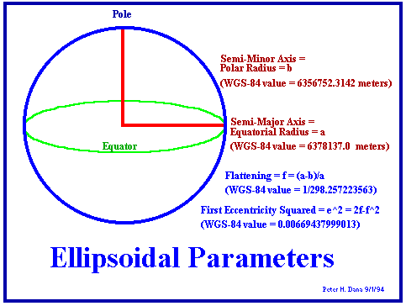
Coordinate Systems
Coordinate systems are based on geodetic datums
Datums define the size and shape of the earth
The initial point of the coordinate system is determined by the projection, ellipse model and datum
Common datums in the US:
North American Datum 1927
North American Datum 1983
World Geodetic System

Slide 10
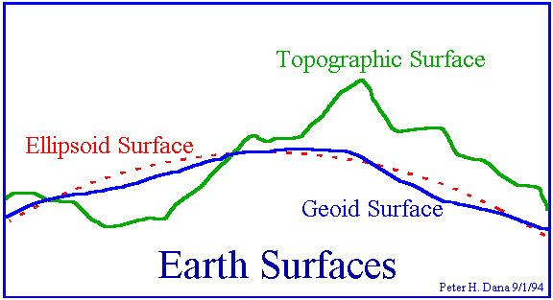
Coordinate System Datums
Types of geodetic datums/ ellipse (spheroid) models:
Topographical surface – surface of the earch is the actual surface of land and sea at some moment in time
Sea level – average surface of the oceans where tidal forces and gravity cause this smoothed surface to vary
Gravity models – attempt to describe variations in the gravity field, and local variations in gravity cause this to be irregular

Slide 11
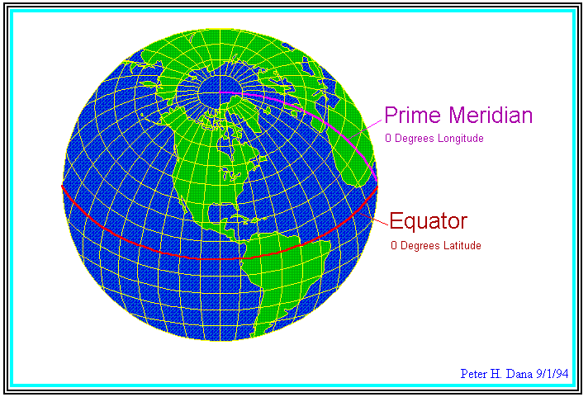
Coordinate Systems Latitude-Longitude System
Most commonly used coordinate system
No transformations necessary between areas
Scale, shape and direction distortion all increase with increasing area of interest

Slide 12
Map Projections
A map projection is a portrayal of the earth’s surface onto a flat surface
There is no universally perfect projection system
Projection classifications
Area/shape distortion
Equivalent (Equal Area) – Area is similar on globe and flat map, but shape is not
Conformal – Shape (scale) is similar on globe and flat map, but the area is not
Shape of projection
Cylindrical – projection of sphere onto a cylinder
Conic – projection of sphere onto a cone
Azimuthal – projection of a sphere onto a plane
Miscellaneous

Slide 13
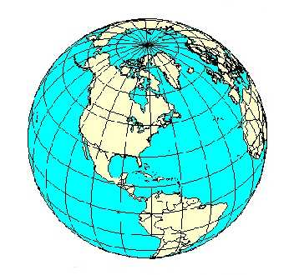
Map Projections
Meridians
North-South lines (such as Longitude)
Parallels
East-West lines (such as Latitude)

Slide 14
Cylindrical Projections
Characteristics:
Straight meridians and parallels
Meridians equally space
Parallels unequally spaces
Common cylindrical projections
Mercator
Universal Mercator

Slide 15
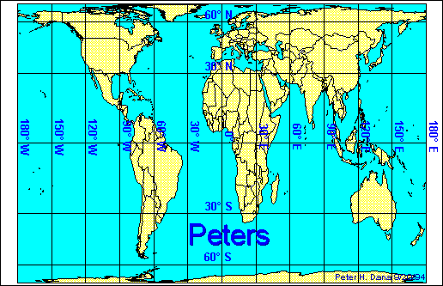
Cylindrical Projections - Peters
De-emphasizes exaggerations in the high latitudes

Slide 16
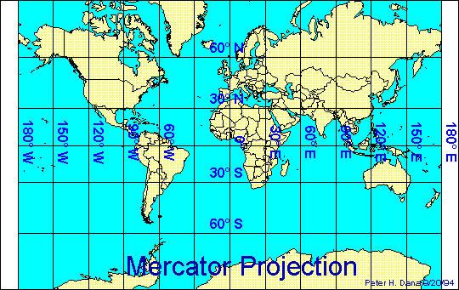
Cylindrical Projections - Mercator
Emphasizes exaggerations in the high latitudes

Slide 17
Conic Projections
Characteristics:
Straight meridians, curved parallels
Meridians radiate from poles
Parallels may be equally spaces
Common conic projections
Albers
Lambert
Polyconic

Slide 18
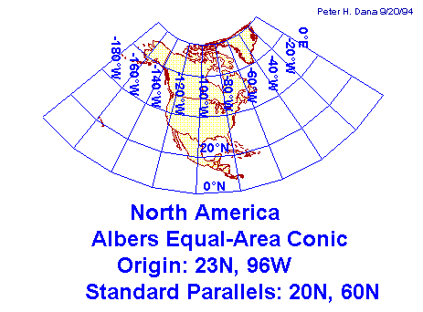
Conic Projections – Albers Equal Area
Direction, area and shape are distorted away from the standard parallels
Area and directions are true only in limited portions of a map

Slide 19
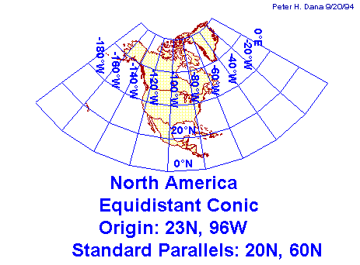
Conic Projections - Equidistant
Direction, area and shape distorted away from the standard parallels
Areas and directions are true only in limited portions of the map

Slide 20
Azimuthal Projections
Characteristics:
Straight or curved meridians, curved parallels
Meridians radiate from poles
Parallels may be equally spaced

Slide 21
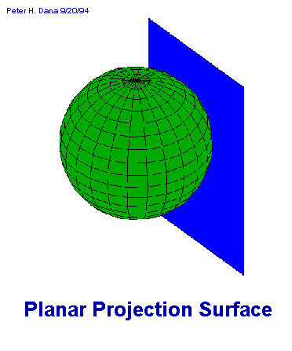
Azimuthal Projections - Orthographic
Simplest form is orthogonal projection
Adequate only for very small areas
Scale and area distortion increases as distance from the tangent center increases

Slide 22
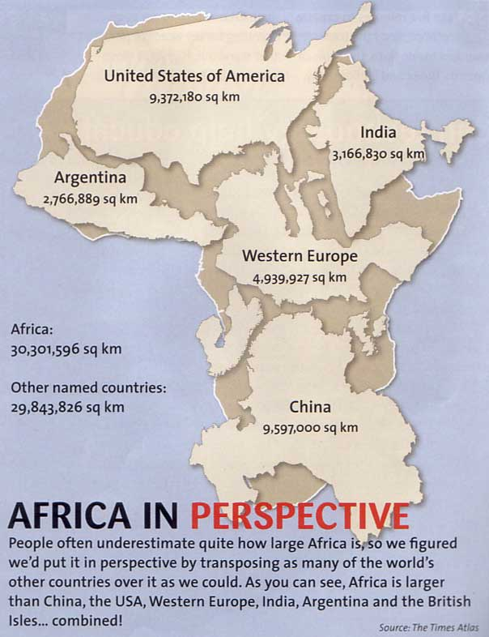

Slide 23
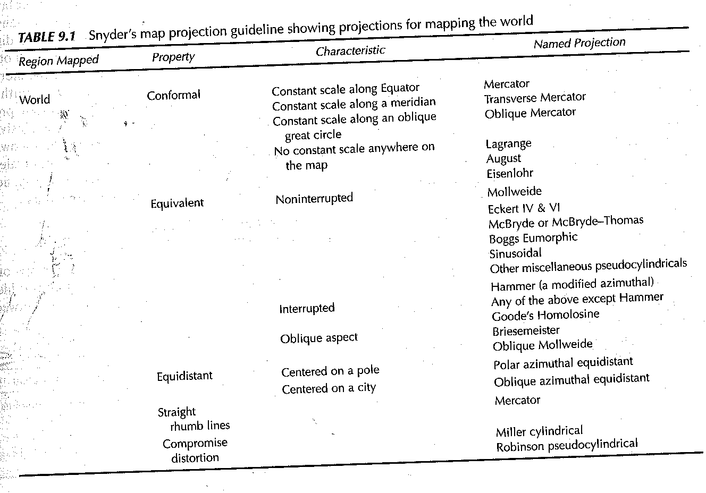
What Projection Should I Use?
TA Slocum, RB McMaster, FC Kessler and HH Howard, “Thematic Cartography and Geovisualization,” Prentice Hall Series, 2009.

Slide 24
Map Elements and Typography
It is a cartographer’s job to select appropriate map elements and to implement them within the available space
Map Elements
Frame line and neat line
Mapped area
Inset
Title and subtitle
Legend
Data source
Scale
Orientation
TA Slocum, RB McMaster, FC Kessler and HH Howard, “Thematic Cartography and Geovisualization,” Prentice Hall Series, 2009.

Slide 25
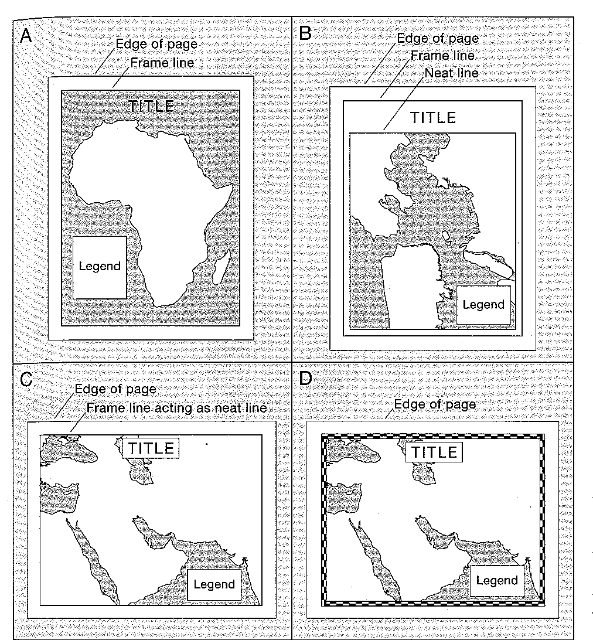
ROSS INSERT IMAGE PG. 191
TA Slocum, RB McMaster, FC Kessler and HH Howard, “Thematic Cartography and Geovisualization,” Prentice Hall Series, 2009.

Slide 26
Legend
Map element that defines all of the thematic symbols of the map
Symbols that are self explanatory or not directly related to the map’s theme can be omitted
Symbols should be vertically centered with their definition
Textual definitions should be horizontally centered
Legend heading can be used to further explain the maps theme
Scale is added to indicate the distances
TA Slocum, RB McMaster, FC Kessler and HH Howard, “Thematic Cartography and Geovisualization,” Prentice Hall Series, 2009.

Slide 27
Typography
Avoid use of decorative type families
Use bold and italic type sparingly
Script, cursive and ornate style are difficult to read
Attempt to reserve italics for hydrographic (water) features or to identify the data source (slanted form resembles the flow of water)
Avoid using more than two type families on a given map
Choose a realistic lower limit for all type size (all type needs to be readable)
Type size should correspond with the size or importance of map features
TA Slocum, RB McMaster, FC Kessler and HH Howard, “Thematic Cartography and Geovisualization,” Prentice Hall Series, 2009.

Slide 28
Specific Guidelines for Map Elements
Orient type horizontally when possible
One exception is when labeling diagonal or curved features
Avoid overprinting (i.e., when a block of type is placed on top of a map feature obscuring the type)
Ensure type is placed so that it is clearly associated with the feature it is representing
TA Slocum, RB McMaster, FC Kessler and HH Howard, “Thematic Cartography and Geovisualization,” Prentice Hall Series, 2009.

Slide 29
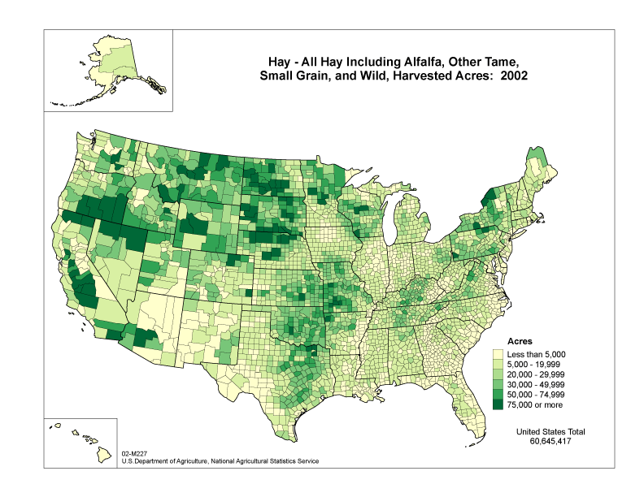
Choropleth Maps¹
Areas of the map are shaded in proportion to a measured variable
Coloring is based on a classification (histogram binning) of the distribution of the measured variable
http://www.nass.usda.gov
1 – J. K. Wright. Problems in Population Mapping. Notes on Statistical Mapping, with Reference to the Mapping of Population Phenomena. AGS and Population Association of America, p. 1-18, 1938.

Slide 30
Choropleth Maps
Earliest known choropleth map was created in 1826 by Baron Pierre Charles Dupin
Term choropleth map was coined in 1938 by John Kirtland Wright
Choropleth maps are based on statistical data aggregated over defined geographical regions
Tobler W., (1970) "A computer movie simulating urban growth in the Detroit region". Economic Geography, 46(2): 234-240

Slide 31
Coloring Choropleth Maps¹
The number of colors depends on the number of classes (bins)
Too many classes can overwhelm the user and distract them from seeing trends
Too many classes can compromise legibility as colors become difficult to distinguish
Typical cartographic rule of thumb is 5-7 classes
Typical coloring schemes⁸ include sequential, divergent and qualitative
For more details on mapping as a visual representation, see ²
1 – C. A. Brewer. http://colorbrewer.org
2 – A. MacEachren. How Maps Work. Guilford Press, 1995.

Slide 32


Color Schemes¹
11 – C. A. Brewer. http://colorbrewer.org
Sequential Color Schemes
Suited for ordered data
Lightness steps dominate the look of the scheme
Light values are low data values, dark are high
Good for Ordinal, interval and ratio data types
Diverging Color Schemes
Puts an emphasis on critical midrange values
Color change represents deviation from a meaningful midrange critical value
Good for ratio data types where looking at data above and below a ‘zero’ point
Qualitative Color Schemes
Does not imply magnitude difference
Used to show differences between classes
Good for Nominal data types
1 – C. A. Brewer. http://colorbrewer.org

Slide 33
Class Interval Selection
The visual representation of the choropleth map is highly influenced by the class interval selection
This is similar to the concept of histogram binning
Popular choices for class interval selection include
Equal interval selection
Jenks’ Natural Breaks¹
Minimum boundary error²
Again, these choices for optimizing the class interval selection are highly dependent on the underlying data distribution
1– G. F. Jenks. The data model concept in statistical mapping. International Yearbook of Cartography, 26:186-190, 1967.
2 – E. K. Cromley and R. G. Cromley. An analysis of alternative classifications schemes for medical atlas mapping. European Journal of Cancer. Series B (Methodological), 26(2):211-252, 1964.

Slide 34
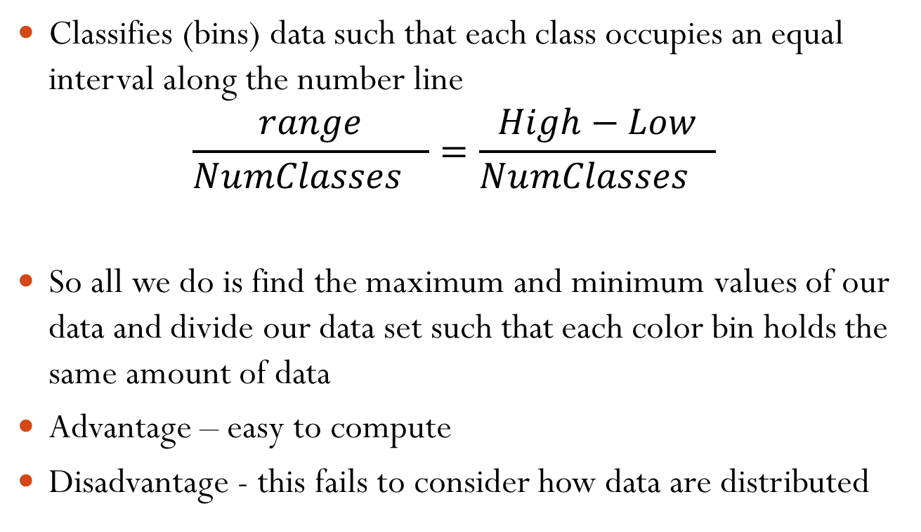
Equal Interval
Classifies (bins) data such that each class occupies an equal interval along the number line
$$\frac{range}{Nu{mClasses}_{}}=\frac{High−Low}{Nu{mClasses}_{}}$$
So all we do is find the maximum and minimum values of our data and divide our data set such that each color bin holds the same amount of data
Advantage – easy to compute
Disadvantage - this fails to consider how data are distributed
TA Slocum, RB McMaster, FC Kessler and HH Howard, “Thematic Cartography and Geovisualization,” Prentice Hall Series, 2009.

Slide 35
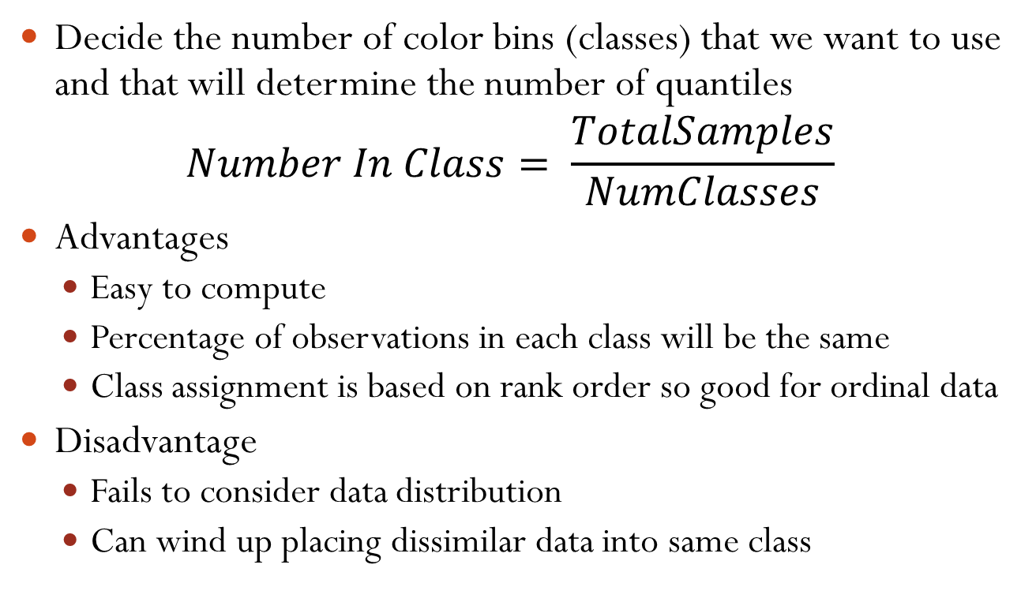
Quantiles
Decide the number of color bins (classes) that we want to use and that will determine the number of quantiles
$$Number In Class= \frac{TotalSamples}{NumClasses}$$
Advantages
Easy to compute
Percentage of observations in each class will be the same
Class assignment is based on rank order so good for ordinal data
Disadvantage
Fails to consider data distribution
Can wind up placing dissimilar data into same class
TA Slocum, RB McMaster, FC Kessler and HH Howard, “Thematic Cartography and Geovisualization,” Prentice Hall Series, 2009.

Slide 36
Mean-Standard Deviation
Classes are formed by adding or subtracting some number of standard deviations from the mean
Advantages:
If data are normally (or near normally) distributed, the mean serves as a useful dividing point
Legend will contain no gaps
Disadvantages:
Only works well only with data that are normally distributed
TA Slocum, RB McMaster, FC Kessler and HH Howard, “Thematic Cartography and Geovisualization,” Prentice Hall Series, 2009.

Slide 37
Maximum Breaks
Goal is to consider individual data values and group those that are similar
Order data for low to high and differences between adjacent values are computed
The largest differences (“breaks”) are used for the class divisions
Advantages:
Easy to compute
Disadvantages:
May miss natural clusters
TA Slocum, RB McMaster, FC Kessler and HH Howard, “Thematic Cartography and Geovisualization,” Prentice Hall Series, 2009.

Slide 38
Natural Breaks
Data values are examined visually to determine logical breaks (or clusters) within the data
Goal is to minimize differences between data values in the same class and maximize differences between different classes
Advantage:
Tries to take into account natural underlying structure of the data
Disadvantage:
Subjective, different mapmakers may choose other values
TA Slocum, RB McMaster, FC Kessler and HH Howard, “Thematic Cartography and Geovisualization,” Prentice Hall Series, 2009.

Slide 39
Optimal Classification
Same as natural breaks, but minimizes an objective function (think of what we talked about with PCA, MDS, etc.)
Goal is to place values into groups (classes, bins)
Measure an “error” – common is to use the sum of absolute deviations about class medians
Calculate each class median and then add the resulting sums of absolute deviations
Many computer based algorithms have been developed to do this:
Jenks-Caspall
Fisher-Jenks
Advantages:
Good empirical method for grouping data
Can assist in determining appropriate number of classes
Disadvantages:
Hard to explain to novice users
May leave gaps in the map legend
TA Slocum, RB McMaster, FC Kessler and HH Howard, “Thematic Cartography and Geovisualization,” Prentice Hall Series, 2009.

Slide 40
Utilizing Spatial Context
The classification methods described do not consider the spatial context of the data
Goal was to simplify the appearance of the map
What if we want to have our classification also take into account spatial relationships?
TA Slocum, RB McMaster, FC Kessler and HH Howard, “Thematic Cartography and Geovisualization,” Prentice Hall Series, 2009.

Slide 41
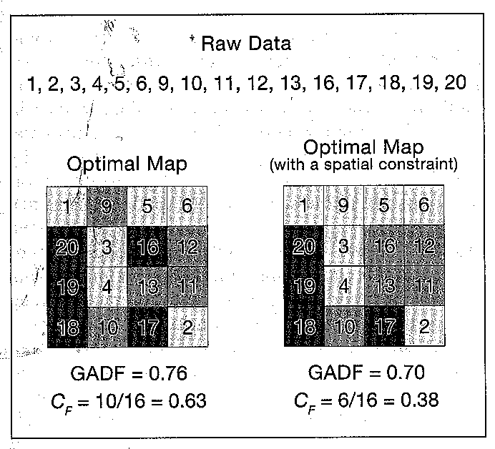
TA Slocum, RB McMaster, FC Kessler and HH Howard, “Thematic Cartography and Geovisualization,” Prentice Hall Series, 2009.

Slide 42
Choropleth Maps
Need to standardize the statistics
Divide by population
Divide by area
Need to be aware that size of areas can cause visual perception issues
Modifiable areal unit problem – source of statistical bias occurring when data is aggregated into districts
Ecological Fallacy – inferences about the nature of individuals are based solely upon aggregate statistics collected for the group to which those individuals belong
Assumes that individual members of a group have the average characteristics of the group at large
However, group characteristics do not necessarily apply to individuals within that group

Slide 43
Dasymetric Map
Like choropleth, uses areal symbols to represent presumed zones of uniformity
However, bounds of the zones need not match the unit boundaries
Redistribution of data is done through use of ancillary information
For example land use/land cover data, you could use this to distribute horse between rural and urban areas more accurately
TA Slocum, RB McMaster, FC Kessler and HH Howard, “Thematic Cartography and Geovisualization,” Prentice Hall Series, 2009.

Slide 44
Dasymetric Map
In choropleth map, phenomena are not often uniformly distributed across an area
Key to dasymetric mapping is the use of ancillary information
Methods for automatic creation of dasymetric map
Binary method – divide land use into habitable and uninhabitable
Intelligent dasymetric mapping – utilizes cartographers domain knowledge and ancillary records
TA Slocum, RB McMaster, FC Kessler and HH Howard, “Thematic Cartography and Geovisualization,” Prentice Hall Series, 2009.

Slide 45
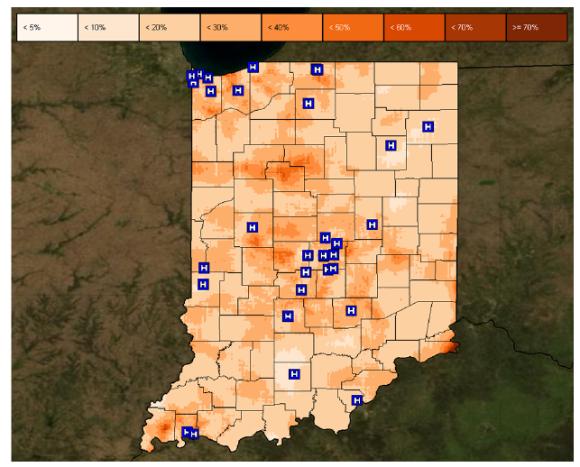
Isopleth Map
Isarithmic map or contour map is created by interpolating a set of isolines between sample pints of known values
Created from collection of point data and then interpolating unknown values between them
Interpolation methods:
Kernel density estimation (see earlier lectures)
Inverse distance
Kriging
TA Slocum, RB McMaster, FC Kessler and HH Howard, “Thematic Cartography and Geovisualization,” Prentice Hall Series, 2009.

Slide 46
Proportional Symbol Mapping
Represent numerical data associated with point locations
Utilizes a symbol and scales the size to show data
Proportional symbols can be used for two forms of point data
True point data – actual measurements at point locations (number of calls made from a phone booth)
Conceptual point data – data collected over an area, but data is conceived as being located at points (for example the centroid)
TA Slocum, RB McMaster, FC Kessler and HH Howard, “Thematic Cartography and Geovisualization,” Prentice Hall Series, 2009.

Slide 47
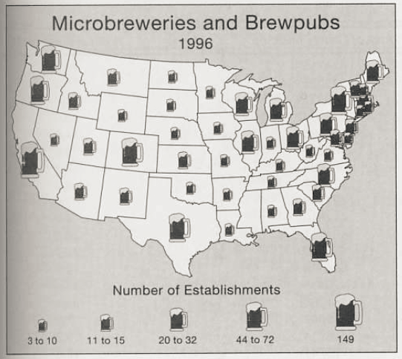
Proportional Symbol Mapping
Geometric symbols – use of shapes that does not necessarily mimic phenomenon occurring
Pictographic symbols – heads of wheat, cows, etc. to mimic types of occurrence
TA Slocum, RB McMaster, FC Kessler and HH Howard, “Thematic Cartography and Geovisualization,” Prentice Hall Series, 2009.

Slide 48
Proportional Symbol Mapping
Major issue is deciding how large symbols should be and how much overlap there will be
Need to be cognizant of perceptual interpolation of sizing of symbols
Need to consider legend design, symbol overlap and symbol redundancy
Redundant symbols represent a single attribute through the use of two visual variables (e.g. size and color)
TA Slocum, RB McMaster, FC Kessler and HH Howard, “Thematic Cartography and Geovisualization,” Prentice Hall Series, 2009.

Slide 49
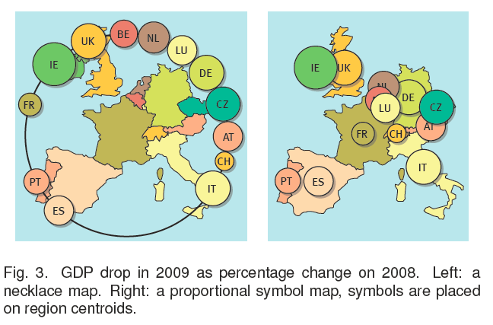
Necklace Map
Speckmann, B and Verbeek, K. "Necklace Maps," IEEE Transactions on Visualization and Computer Graphics 16(6): 881-889, 2010

Slide 50
Cartogram
Technique in which spatial geometry is distorted to reflect a theme
For example, sizes of counties may be made proportional to the population of each county
Most common cartogram would be distance cartogram, where lengths on map are scaled to travel time (e.g., subway maps with length scaled to time ride on subway)
Gastner and Newman developed approaches using physics to maintain topography for digital cartograms¹
Gaster, MT and Newman, MEG. “Diffusion based method for producing density-equalizing maps,” Proceedings of the National Academy of Sciences 101(20): 7499-7504

Slide 51
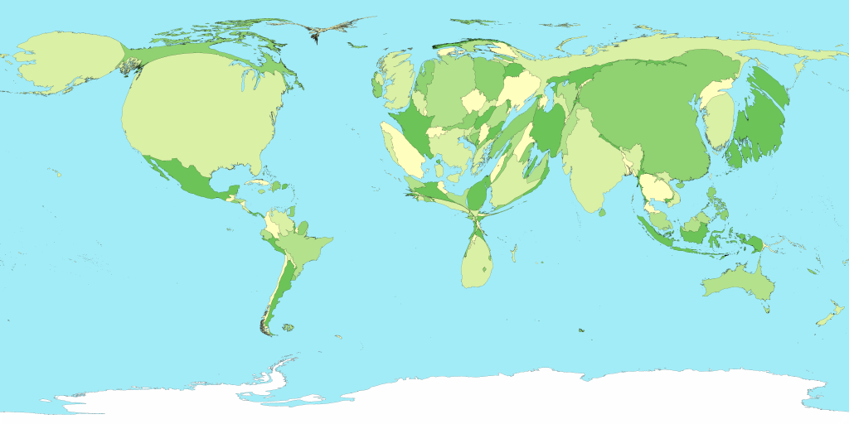
Cartogram
Cartogram of Gross Domestic Product by Country:
http://www-personal.umich.edu/~mejn/cartograms/

Slide 52
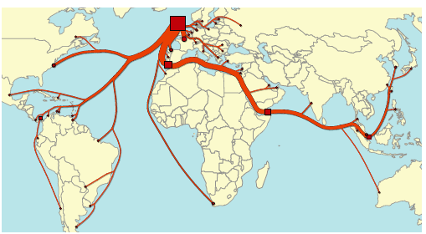
Flow Map
Whiskey Exports from Scotland
Buchin K, Speckmann, B, Verbeek, K. "Flow Map Layout via Spiral Trees," IEEE Transactions on Visualization and Computer Graphics 17(12): 2536-2544, 2011

Slide 53
Readings and Homework
Required Reading:
Dykes, J.; Wood, J.; Slingsby, A.; , "Rethinking Map Legends with Visualization," IEEE Transactions on Visualization and Computer Graphics, vol.16, no.6, pp.890-899, Nov.-Dec. 2010
Gaster, MT and Newman, MEG. “Diffusion based method for producing density-equalizing maps,” Proceedings of the National Academy of Sciences 101(20): 7499-7504
Buchin K, Speckmann, B, Verbeek, K. "Flow Map Layout via Spiral Trees," IEEE Transactions on Visualization and Computer Graphics 17(12): 2536-2544, 2011
Speckmann, B and Verbeek, K. "Necklace Maps," IEEE Transactions on Visualization and Computer Graphics 16(6): 881-889, 2010.
Homework
Homework #3 is due Monday!

